Slide 1


Engaging Front Line Workers in Oral Health Advocacy
Connecticut Department of Public Health
Developed by the Connecticut Oral Health Initiative, Inc.
May 2018
Notes:
The Engaging Front Line Health Workers in Oral Health Advocacy is to educate all types of front line health workers, who work across a variety of settings under many different titles.
As these workers are trusted members of their community and share in the culture of those they serve, they provide outreach, advocacy, patient education, care coordination, health care navigation, and social support.
This training is a focus on oral health advocacy.
This module was developed by Mary Moran Boudreau, RDH of the Connecticut Oral Health Initiative, Inc., Hartford, CT with a contract from the Connecticut Department of Public Health.
Photo retrieved from www.shutterstock.com/image-photo/grandmother-her-son-granddaughter-3-generations-248158957?src=retC-bdFYY7mufKoTfe8Kw-1-19

Slide 2
Oral Health Advocacy for Front Line Workers
This project is supported by the Connecticut Department of Public Health (CT DPH) with funding through the Health Resources and Services Administration (HRSA) of the U.S. Department of Health and Human Services (HHS) under T12HP28885 Oral Health Workforce Grant for $1,200,000. This information or content and conclusions are those of the author and should not be construed as the official position or policy of, nor should any endorsements be inferred by CT DPH, HRSA, HHS or the U.S. Government.
The images in this presentation are not to be reproduced/downloaded for purposes other than personal use. Republication, retransmission, reproduction, or other use of the Licensed Material is prohibited.
Notes:
This project was supported by the Connecticut Department of Public Health with funding through the Health Resources and Services Administration of the U.S. Department of Health and Human Services.

Slide 3

Purpose of the Training
To empower Front Line Workers to build individual and community capacity to improve oral health of themselves, their families and their clients by influencing for change.
Notes:
The purpose of the training is to help Front Line Workers to develop ways for individuals and communities to improve their oral health by influencing others for change.
Photo retrieved from https://www.dreamstime.com/family-online-free-stock-photo-image-free-6453685
Photo: © Dmitry Ersler ID 6453685 | Dreamstime Stock Photos

Slide 4
Educational Objectives
Recognize barriers to good oral health
Describe the prevalence and impact of oral disease
Define advocacy
Identify role of Front Line Workers in oral health policy and advocacy
Find resources for oral health advocacy
Notes:
The Educational objectives we will addresses are:
To recognize barriers to good oral health
To describe the prevalence and impact of oral disease
To define advocacy
To identify role of Front Line Workers in oral health policy and advocacy; and
To find resources for oral health advocacy

Slide 5

What are the Barriers to Good Oral Health?
Notes:
What are the barriers to good oral health?
(Wait for 3 - 4 answers before going to next slide – about 3 minutes total for this slide)
Photo retrieved from https://www.shutterstock.com/image-photo/group-children-ropepulling-contest-against-just-230760550
Photo By Luis Louro Royalty-free stock photo ID: 230760550

Slide 6
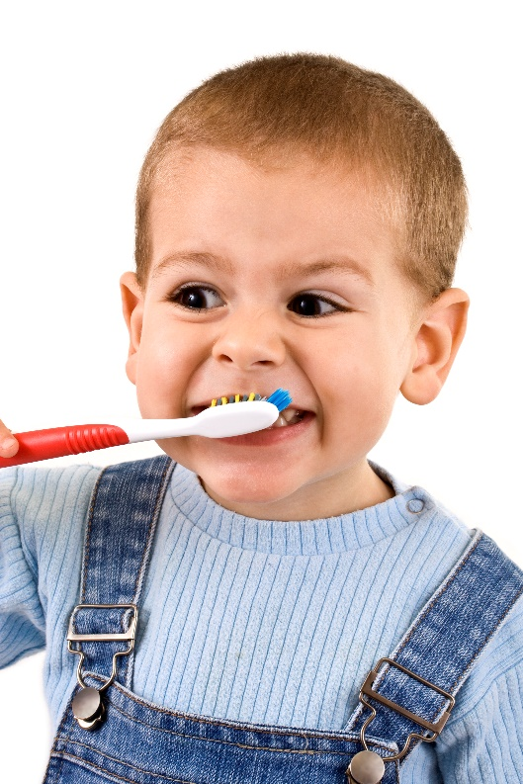
Barriers to Good Oral Health
Affording care
Finding a dentist
Understanding the importance of oral health on overall health
Getting to the dental office
Notes:
The barriers to good oral health are the ones you stated.
Recapping, here are a few of the many barriers:
Affording care
Finding a dentist that is
near my home
speaks my language
understands my culture
understands my needs
Understanding the importance of oral health on overall health
Getting to the dental practice
Photo retrieved from https://www.dreamstime.com/boy-brushing-stock-photo-image-free-11937420
Photo:© Grafvision ID 11937420 | Dreamstime Stock Photos

Slide 7

Who Is Affected by Oral Disease?
Notes:
Who is affected by oral disease?
(Wait for 3 – 4 answers before going onto the next slide, about 3 minutes total for this slide)
Photo retrieved from https://www.shutterstock.com/image-photo/elderly-eighty-plus-year-old-man-254980588?src=UCzQc8_TqcQxKPPnhchNcQ-2-2
Photo: By Fotoluminate LLC Royalty-free stock photo ID: 254980588

Slide 8




Who Is Affected by Oral Disease?
In Connecticut
Kindergarteners with dental decay
Third Graders with dental decay
http://www.ctoralhealth.org/files/9815/1543/3770/Every_Smile_Counts_2017_Book_for_web.pdf
Notes:
It does not matter the age, gender, race, ethnicity, culture, socioeconomic level or other factors… they are all affected by dental disease. Over the next 3 slides, I will share with you some data.
Here are just a couple findings from the Every Smile Count statewide survey of kindergarten and Grade 3 children from a representative sample of elementary schools in 2017.
1 in 3 children in kindergarten have had decay experience. It grows to 2 in 5 third grade student who have cavities or fillings.

Slide 9
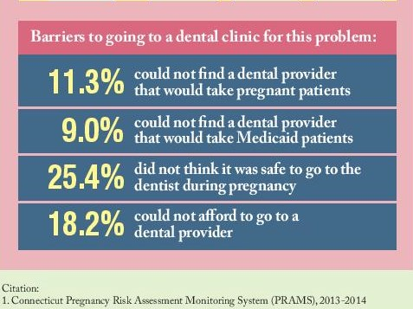
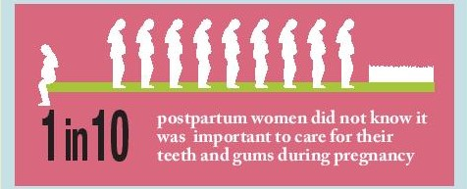
Who is Affected by Oral Disease?
Notes:
From the PRAMS, the Pregnancy Risk Assessment Monitoring System, is a surveillance project of the Centers for Disease Control and Prevention (CDC), it was found in Connecticut that 1 in 10 postpartum women did not know that it was important to care for their teeth and gums during pregnancy.
Also as you can see on the second chart, that they identified the barriers to dental care, including
Difficulty in finding a dentist who treats pregnant patients;
Difficulty in finding a dentist who take Medicaid patients;
Not knowing it was safe to get dental care at the dentist office during pregnancy; and
Not being able to afford dental care.

Slide 10




Who Is Affected by Oral Disease?
In Connecticut
Older adults in Long Term Care have untreated dental decay
Older adults at Congregate Meal sites need early or urgent dental care
http://www.portal.ct.gov/-/media/Departments-and-Agencies/DPH/dph/oral_health/PDF/VulnerableAdultOralHealthReportpdf.pdf?la=en
Notes:
Going to another age group, according to the 2013 report of a statewide survey of a representative sample of older adults in long-term care centers and at meal sites in places like senior centers completed by the Department of Public Health in 2013, 1 out of two older adults have untreated decay (or cavities that need dental treatment).
1 out of 4 older adults at congregate meal sites….those able to get out of the house…. Need early or urgent dental care.
These are just a few statistics to demonstrate that oral disease impacts the whole population of Connecticut.

Slide 11
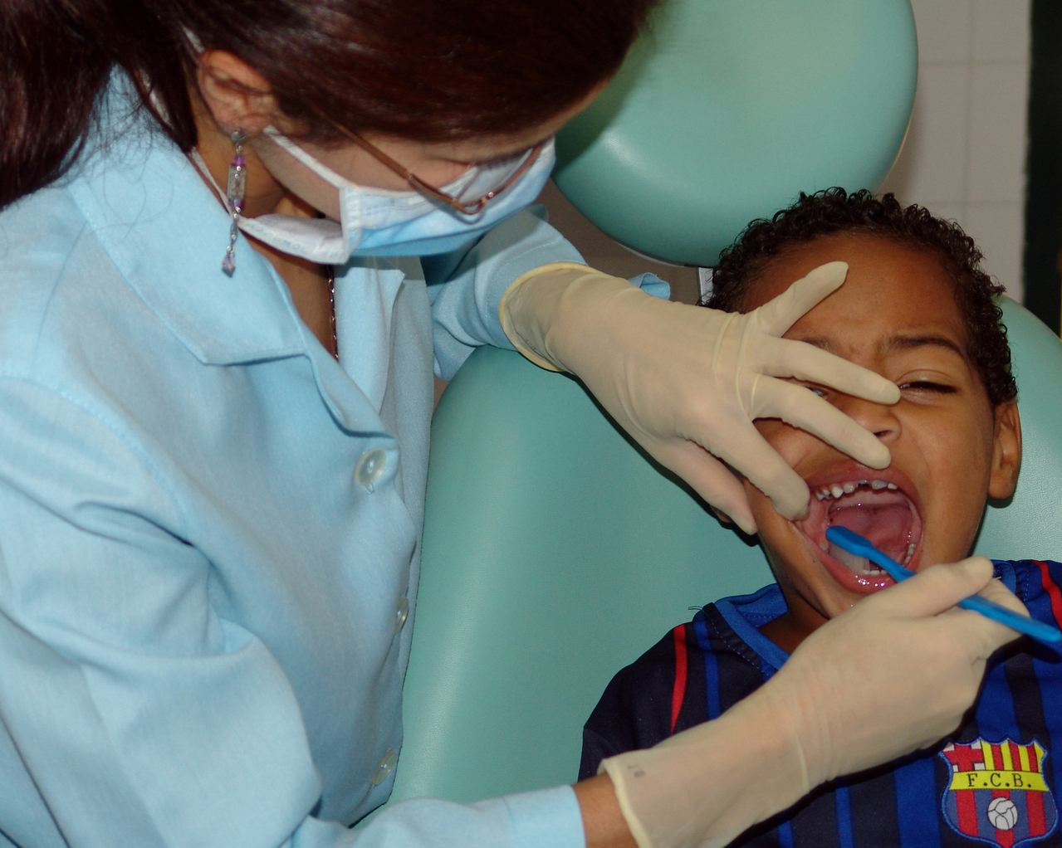
What Is Oral Health Advocacy?
Why Advocate?
Notes:
What do you think oral health advocacy is or asked in another way, why should we advocate for oral health?
(Wait for 1- 2 responses before going to the next slide, about 2 minutes total for this slide)
Photo retrieved from https://www.freeimages.com/photo/dentist-1438299
Photo: Moraes, M.C. freeimages.com/photo/dentist-1438299

Slide 12

What Is Advocacy?
Advocacy is the act of “taking a position on an issue, and initiating actions in a deliberate attempt to influence private and public policy choices.”
Shout Out for Oral Health
Quote: http://www.greenpeace.org/international/en/campaigns/climate-change/cool-it/Advocacy/
Notes:
There are two parts to advocacy
Caring about something…..be it an issue, problem or a condition that is important to you
And then
Convincing others to care about it too.
You advocate to make a difference. What is bothering you? What needs to change in your opinion?
One of the things you can do is to tell others about it. Tell them why it bothers you and why it should be something that concerns them.
Photo: © Publicdomainphotos ID 96751881 | Dreamstime Stock Photos

Slide 13


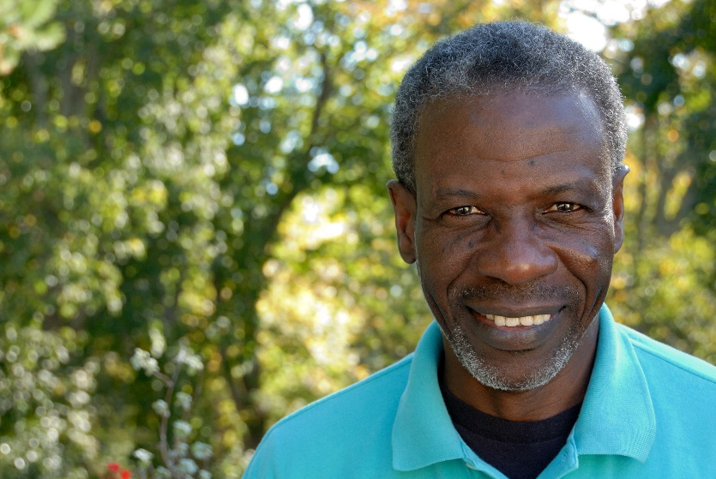
Who Can You Influence?
Notes:
Who Can You Influence?
(Wait for a few examples before going to the next slide – about 2 minute total for this slide)
Left Photo retrieved from https://www.dreamstime.com/mother-children-stock-image-image-free-4586311:Photo: © Vstock ID 4586311 | Dreamstime Stock Photos
Center Photo retrieved from https://www.dreamstime.com/senior-reading-free-stock-photo-image-free-2609805:Photo: © Geotrac ID 2609805 | Dreamstime Stock Photos
Right Photo retrieved from https://www.dreamstime.com/friendly-mature-man-stock-photography-image-free-4041092:Photo: © Terence Mendoza ID 4041092 | Dreamstime Stock Photos

Slide 14
Who Can You Influence?
Dental Providers
Neighbors
Schools
Health Agencies
Community Programs
Health Providers
Family & Friends
Faith-based organizations
Clients
Your legislators
Notes:
As you can see, you have a big choice. Think about the one person from one of the groups on this list and that is who you can state with today.

Slide 15

How to Advocate?
Notes:
How do you or others advocate? What do you need to do to share your concern and ask for a change?
(Wait for a couple answers from the group for about 2 minutes and then go to next slide)
Photo retrieved from https://www.dreamstime.com/couple-holding-blank-banner-free-stock-image-image-free-2987366; © Roxana Gonzalez ID 2987366 | Dreamstime Stock Photos

Slide 16

How to Advocate?
Prepare
Implement
  Build relationships
  Gain partnerships
Sustain
  Keep involving partners
  Incorporate others ideas
Notes:
There are basically three steps to advocacy. Preparing, Implementing and Sustaining. Over the next few minutes, I will define these three steps, and then as a group we will discuss how you can actually do these steps.

Slide 17

Prepare
Set Goal
Assess the community
Respect diversity
Notes:
To prepare, you want to:
Set Goal
What do you want to change and how?
Assess the community
What are the strengths of the community?
What are the weaknesses?
Respect diversity
Who lives there?
Where do they live?

Slide 18

Implement
Build relationships
Gain partnerships
Notes:
The Implement stage is where you
Build relationships with
Clients
Providers
Community leaders
Teachers and so on……
And Gain partnerships with
Faith-based organizations
Legislators
Coalitions
Community groups and
With others
Photo retrieved from https://www.freeimages.com/photo/business-meeting-1239191:Photo: Eustatiu, M. freeimages.com - 1239191

Slide 19

Sustain
Keep involving partners
  Meetings
  Calls
  Emails…..
Incorporate others’ ideas
  Listen
  Develop ideas
Notes:
You sustain interest and concern of others by
Keep involving partners with
Meetings
Calls
Emails…..and by
Incorporate others’ ideas by
Listening
Develop ideas
Photo retrieved from https://www.dreamstime.com/business-man-meeting-stock-images-image-free-4387604:Photo: © Pemotret ID 4387604 | Dreamstime Stock Photos

Slide 20

What do YOU talk about?
Talk about what you care about
Talk about what you want them to change
Notes:
Now, let’s put these steps into practice.
What do YOU talk about?
Talk about what you care about
Talk about what you want them to change
Now I turn it to you, give me about 3 things you care about oral health that you want to change?
(Wait for a few answers and then move on the next slide – about 2 minutes for this slide)
Photo retrieved from https://www.dreamstime.com/cute-african-american-child-stock-photos-image-free-2188763:Photo: © Jeffrey Banke ID 2188763 | Dreamstime Stock Photos

Slide 21
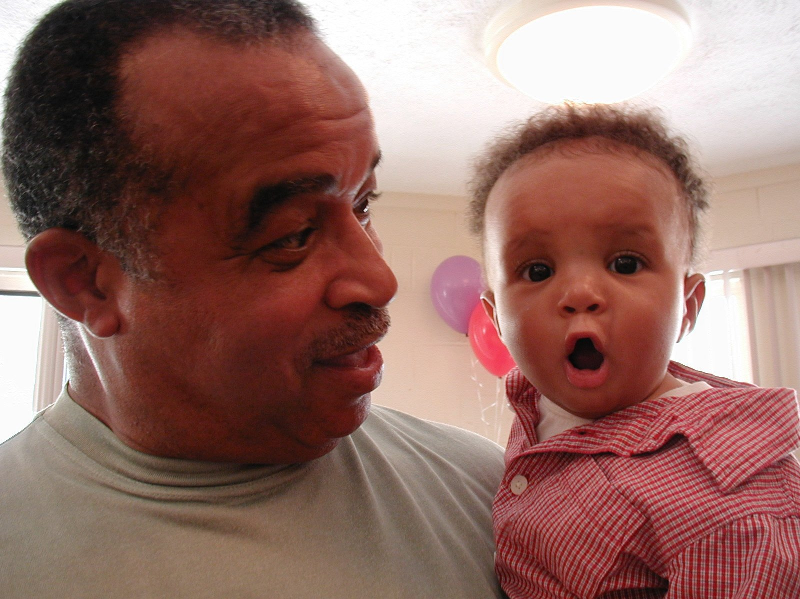
What do you want them to change?
Notes:
What do you want them to change?
(Wait for a couple answers. If they don’t know, ask what barriers they want to change - about 3 minutes in total for this slide)
Photo retrieved from https://www.freeimages.com/photo/the-o-face-1251335:Photo: Thompson, A. freeimages.com -1251335

Slide 22
What do you want them to change?
Gaining access to care
Affordability
Insurance coverage
Improve language and/or cultural sensitivity
Make oral health important
Transportation
Finding a dentist
Notes:
Here are a few examples for oral health:
Gaining access to care
Affordability
Oral health is an essential health benefit under the Affordability Care Act for children. In Connecticut, pediatric dental care is part of all qualified health plans with no extra premium.
Insurance coverage
Improve language and/or cultural sensitivity
Make oral health important
Transportation
Finding a dentist

Slide 23

Where do you advocate for oral health?
Provide oral health advocacy where you find people
Notes:
Once you know what you want to change, the next step to determine where to advocate. Where are some place you can find people to help you make a change?
(Provide a few minutes for the group to give some answers –Once they have provided a few answers, read the list below)
Provide oral health advocacy where you find people, for example
At home
In neighborhood
At schools
At faith-based organizations
At the town hall
At the state capitol
YOUR work site – in other words, YOUR Clients
At the dental practice
At the health center/practice
Photo retrieved from https://www.freeimages.com/photo/meet-the-geese-family-1-1374111:Photo: Nyberg. J. freeimages- 1-1374111

Slide 24
The Ask
Specific and Feasible “Ask”
  A clearly defined action or question
  An action that likely can be done
Simple and Respectful requests
  Not complex for the person(s) to do the action
  Consider the feeling of the person
Notes:
It is important to prepare some specific and feasible asks.
What do I mean by “the ask”? It is what you are asking to activate others in a shared action within a certain context. It asking them for a commitment to some action that you have agreed upon.
The requests should be:
specific and feasible (do-able)
simple and respectful
such as “Would you be willing to meet with our group next month to discuss accessibility of oral health services?”
This is much easier than big/complicated demands, such as “You need to keep your clinic open on weekends.” The people you may be talking to:
May not in a position to change or make a decision on a major issue right away;
May have a better solution;
May come up with the solution you want, but have more “buy-in” or more motivation to make the change when it was their idea.
What other “Asks” can you share with the group?

Slide 25

How Can You Build and Sustain Relations?
Notes:
What are some of the ways you can build and sustain relationships to keep movement on you new cause?
You want to:
understand the priorities and concerns of your audience
think about how your advocacy goals fit with those priorities and concerns
When you do this, you then have built partners for moving you concern forward to solutions.
© SmillaID 3883635 | Dreamstime Stock Photos
Photo retrieved from https://www.dreamstime.com/three-businesswoman-laptop-free-stock-photo-image-free-3883635

Slide 26
Oral Health Advocacy Exercise
What is an oral health situation that you care about and want to change?
How can you influence someone to care about it and make a change?
Notes:
We will now break up into groups of 3 to complete this exercise. Please see the handout.
First talk about what is an oral health situation that you care about and want to change? First, you want to identify:
What is the issue?
Why you care?
Who is affected?
What are possible solutions?
Who is your target for making the change?
Then decide how can you influence someone to care about it and make a change? What would you say?
Take 10 minutes to complete both questions in your group. Then we will share what you practiced.

Slide 27
Advocacy is….
Caring
Convincing others
It is doing the right thing
It is NOT hard and is something you can do now
Notes:
Advocacy is, as we discussed in the beginning, is the act of “taking a position on an issue, and initiating actions in a deliberate attempt to influence private and public policy choices.”
It is caring
It is convincing others
It is not hard and is something you can do right now

Slide 28
Oral Health Resources
  CT Department of Public Health – Office of Oral Health
  http://www.portal.ct.gov/DPH/Oral-Health/oral-health/Office-of-Oral-Health
  Connecticut Dental Health Partnership (HUSKY Dental)
  https://www.ctdhp.com
  Let’s Talk Teeth
  Letstalkteeth.org
  Smiles for Life, a national oral health curriculum
  http://www.smilesforlifeoralhealth.org

Slide 29
Advocacy Resources
  Connecticut Oral Health Initiative, Inc.
  http://www.ctoralhealth.org
  Find your legislator
  https://www.cga.ct.gov/asp/menu/cgafindleg.asp
  Children’s Dental Health Project
  https://www.cdhp.org/
  Community Catalyst
  https://www.communitycatalyst.org/initiatives-and-issues

Slide 30
Contact information
CT Department of Public Health Office of Oral Health
www.ct.gov/dph/oralhealth
Connecticut Oral Health Initiative, Inc.
  http://www.ctoralhealth.org

